Slide 1
Fair Debt Veteran online Debt Access (VODA) Vision
Project Manager: Justin R. Carver
Date: 01/19/2021

Slide 2
Goal
Veterans Fair Debt Notice Act of 2017 (H.R.3705)
https://www.congress.gov/bill/115th-congress/house-bill/3705
Summary
This bill directs the Department of Veterans Affairs (VA) to collaborate with Veterans service organizations to write a standard letter to be provided to individuals who owe debts to the VA. Such letter shall be written in plain language and shall include a notice of the debt and a clear explanation of:
why the individual owes such money, and
(2) available options. The VA shall develop a method by which individuals may elect to receive debt notification letters by electronic means and shall ensure that the letter is delivered:
(1) by both standard mail and electronic means to individuals who have made such election, and
(2) only by standard mail to individuals who have not made such election.
The VA shall:
notify Congress regarding the completion of such letter, and
(2) study and report to Congress on the process by which it notifies veterans of debt collection efforts.
Notes:
Status Summary Link:
https://dvagov-my.sharepoint.com/personal/justin_carver_va_gov/Lists/Fair%20Debt%20VODA%20Status%20Summary/AllItems.aspx?env=WebViewList
Management Alert Link:
https://dvagov-my.sharepoint.com/personal/justin_carver_va_gov/Lists/Fair%20Debt%20VODA%20Management%20Alert/AllItems.aspx?env=WebViewList
Accomplishments Link:
https://dvagov-my.sharepoint.com/personal/justin_carver_va_gov/Lists/Fair%20Debt%20VODA%20Accomplishments%20During%20Reporting%20Pe/AllItems.aspx?env=WebViewList

Slide 3
Goal (Continued)
Veterans Benefits and Transition Act of 2018 (S.2248)
https://www.congress.gov/bill/115th-congress/senate-bill/2884
Summary
This bill directs the Department of Veterans Affairs (VA) to collaborate with Veterans service organizations to write a standard letter to be provided to individuals who owe debts to the VA. Such letter shall be written in plain language and shall include a notice of the debt and a clear explanation of:
(1) why the individual owes such money, and
(2) available options.
The VA shall develop a method by which individuals may elect to receive debt notification letters by electronic means and shall ensure that the letter is delivered:
(1) by both standard mail and electronic means to individuals who have made such election, and
(2) only by standard mail to individuals who have not made such election.
Notes:
Status Summary Link:
https://dvagov-my.sharepoint.com/personal/justin_carver_va_gov/Lists/Fair%20Debt%20VODA%20Status%20Summary/AllItems.aspx?env=WebViewList
Management Alert Link:
https://dvagov-my.sharepoint.com/personal/justin_carver_va_gov/Lists/Fair%20Debt%20VODA%20Management%20Alert/AllItems.aspx?env=WebViewList
Accomplishments Link:
https://dvagov-my.sharepoint.com/personal/justin_carver_va_gov/Lists/Fair%20Debt%20VODA%20Accomplishments%20During%20Reporting%20Pe/AllItems.aspx?env=WebViewList

Slide 4
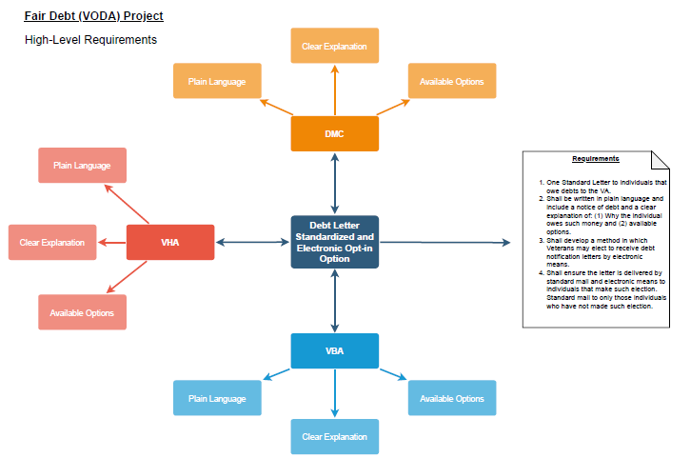
Goal Map
Notes:
Goal of slide:
Provide detail on the major program issues that require senior leadership assistance. There should be separate slides for each of the major issues.
Issues description:
provide a summary of the issue
Actions taken:
describe actions the program team has taken to address the issue.
Next steps:
describe the next steps the program team will take to address the issue.
Senior leadership action needed:
describe precise actions the program team requires of senior leadership.

Slide 5
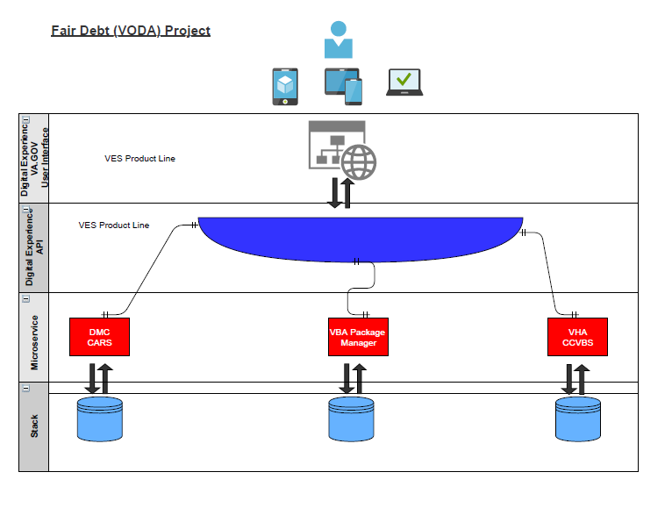
Goal High-Level Architecture
Notes:
Goal of slide:
Provide an overview and health of the program scope.
What is the scope:
Describe the scope. This might be a summary of the epics, capabilities, or summary statement.
Status of scope:
Do we have clear scope?
Are we confident we will clarify scope in time to meet the schedule?
Next steps (30-day look ahead)
Describe next steps in finalizing scope
Issues:
Describe issues with finalizing the scope

Slide 6
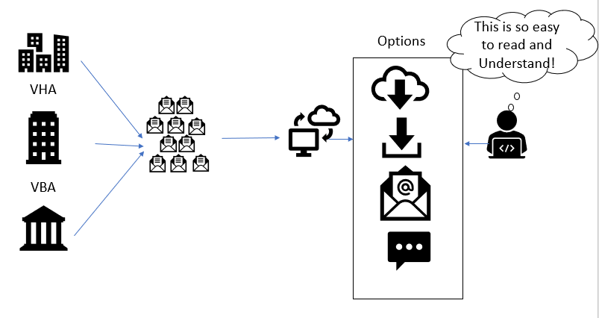
Goal High-Level Depiction
Notes:
Goal of slide:
Provide an overview and health of the program scope.
What is the scope:
Describe the scope. This might be a summary of the epics, capabilities, or summary statement.
Status of scope:
Do we have clear scope?
Are we confident we will clarify scope in time to meet the schedule?
Next steps (30-day look ahead)
Describe next steps in finalizing scope
Issues:
Describe issues with finalizing the scope

Slide 7
Reality
Veterans receive a variety of debt letters from The Department of Veterans Affairs
These letters are confusing and unclear for Veterans
The letters can be generated from any number of places despite the fact they are all from what the Veteran perceives to be a single company or agency. However, internally, The Department of Veterans Affairs operates in silos as it relates to debt management. There is debt collection from DMC, VBA, and VHA. Veterans are required to pay different parts of the agency and follow different protocols dependent on the debt.
The burden is put on the Veteran to understand the differences in “internal” debt silos; rather than the agency owning the burden to create one concise letter with a one stop shop for Veterans to pay their debts to the agency. This will bring the agency in alignment with industry best practices and make debt collection more customer-centric.
Notes:
Goal of slide:
Provide detail on the major program issues that require senior leadership assistance. There should be separate slides for each of the major issues.
Issues description:
provide a summary of the issue
Actions taken:
describe actions the program team has taken to address the issue.
Next steps:
describe the next steps the program team will take to address the issue.
Senior leadership action needed:
describe precise actions the program team requires of senior leadership.

Slide 8
Reality (Continued)
3. Internally, the agency silos do not really have an understanding of what one another are collecting from Veterans or their beneficiaries. Therefore, the internal entities are receiving an isolated view of the Veterans’ debt relationship with the agency as a whole. This puts each silo at a disadvantage from a customer service perspective.
Notes:
Goal of slide:
Provide detail on the major program issues that require senior leadership assistance. There should be separate slides for each of the major issues.
Issues description:
provide a summary of the issue
Actions taken:
describe actions the program team has taken to address the issue.
Next steps:
describe the next steps the program team will take to address the issue.
Senior leadership action needed:
describe precise actions the program team requires of senior leadership.

Slide 9
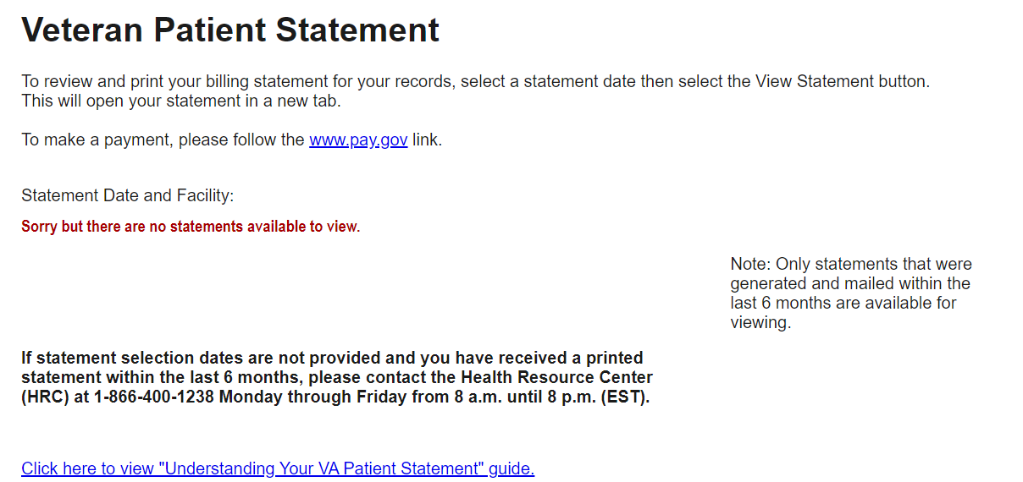
Reality – Current Functionality - VHA
https://eauth.va.gov/VBS/Prod

Slide 10
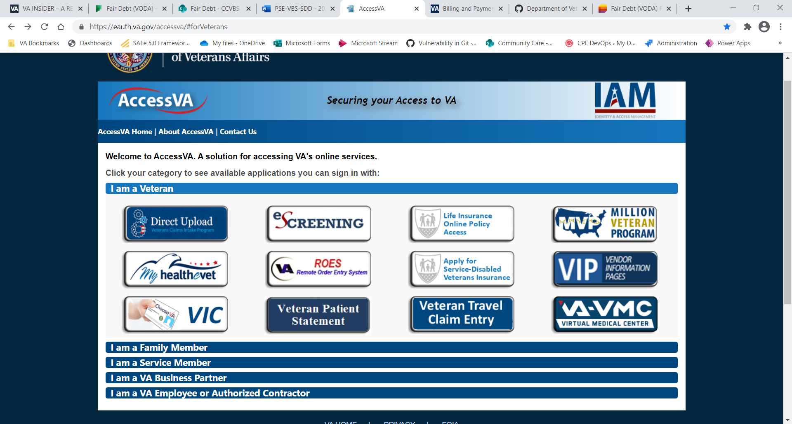
Reality - Current Functionality - IAM Authentication
https://eauth.va.gov/accessva/#forVeterans

Slide 11
Reality - Current Functionality - VBA
Award Letters

Slide 12
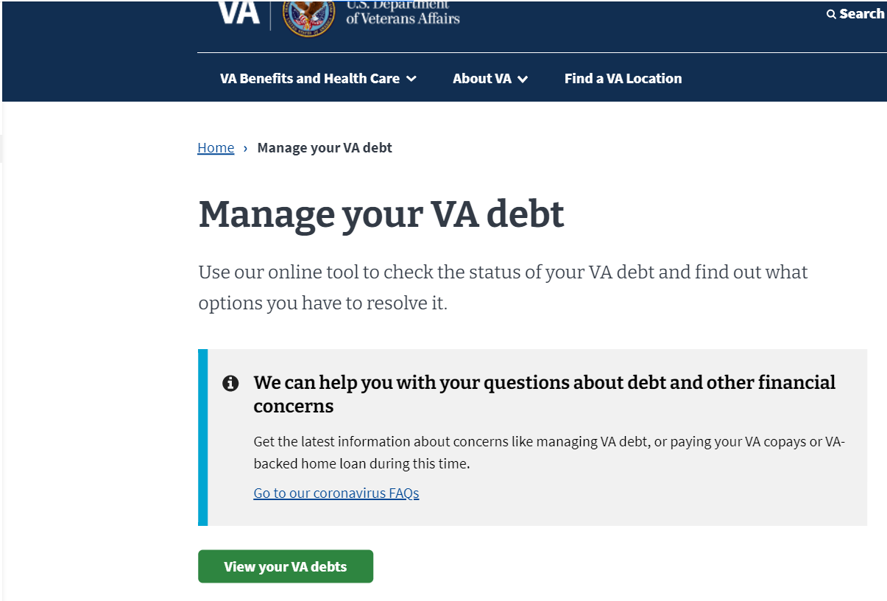
Reality - Current Functionality – VA Debt Portal
http://www.va.gov/manage-va-debt/

Slide 13
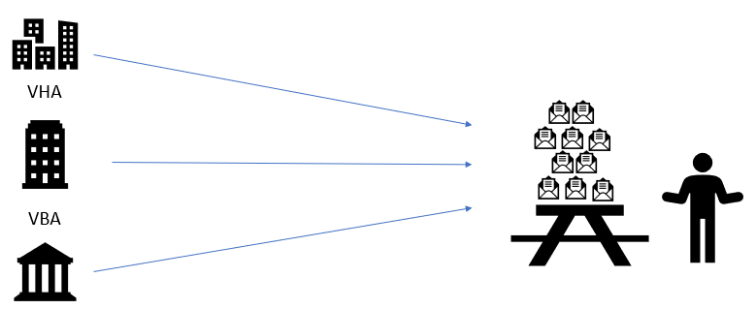
Reality Depiction
Treasury may not make it to consolidation. Therefore, may be necessary to refer.
DMC
Notes:
Goal of slide:
Provide detail on the major program issues that require senior leadership assistance. There should be separate slides for each of the major issues.
Issues description:
provide a summary of the issue
Actions taken:
describe actions the program team has taken to address the issue.
Next steps:
describe the next steps the program team will take to address the issue.
Senior leadership action needed:
describe precise actions the program team requires of senior leadership.

Slide 14
Options
Identify the vision of the project
Identify a timeline for execution of the vision
Identify Resources to help carry out the execution of the vision
Notes:
Goal of slide:
Provide detail on the major program issues that require senior leadership assistance. There should be separate slides for each of the major issues.
Issues description:
provide a summary of the issue
Actions taken:
describe actions the program team has taken to address the issue.
Next steps:
describe the next steps the program team will take to address the issue.
Senior leadership action needed:
describe precise actions the program team requires of senior leadership.

Slide 15
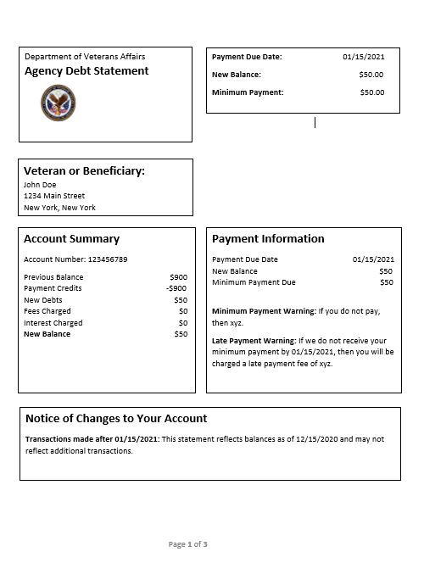
Options – Consolidated Debt Letter View
Notes:
Goal of slide:
Provide detail on the major program issues that require senior leadership assistance. There should be separate slides for each of the major issues.
Issues description:
provide a summary of the issue
Actions taken:
describe actions the program team has taken to address the issue.
Next steps:
describe the next steps the program team will take to address the issue.
Senior leadership action needed:
describe precise actions the program team requires of senior leadership.

Slide 16
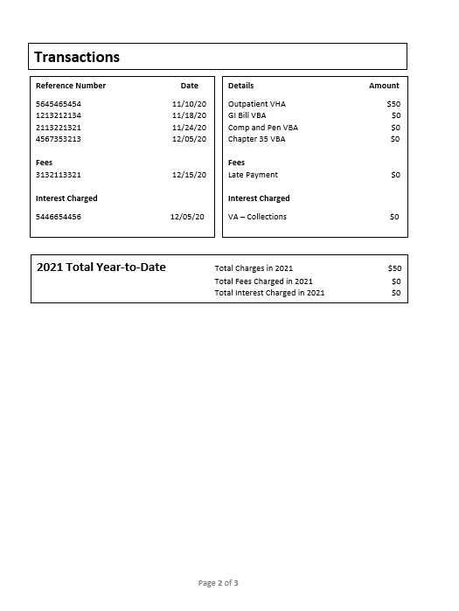
Options – Consolidated Debt Letter View
Notes:
Goal of slide:
Provide detail on the major program issues that require senior leadership assistance. There should be separate slides for each of the major issues.
Issues description:
provide a summary of the issue
Actions taken:
describe actions the program team has taken to address the issue.
Next steps:
describe the next steps the program team will take to address the issue.
Senior leadership action needed:
describe precise actions the program team requires of senior leadership.

Slide 17

Options – Consolidated Debt Letter View
Notes:
Goal of slide:
Provide detail on the major program issues that require senior leadership assistance. There should be separate slides for each of the major issues.
Issues description:
provide a summary of the issue
Actions taken:
describe actions the program team has taken to address the issue.
Next steps:
describe the next steps the program team will take to address the issue.
Senior leadership action needed:
describe precise actions the program team requires of senior leadership.

Slide 18
Way Forward
Lite
DMC Lite
Letter Availability for Download
DMC Availability
VBA Availability
VHA Availability
Letter Available in Digital Form
DMC Availability
VBA Availability
VHA Availability
VBA Lite (Maybe multiple)
VHA Lite
Services Available Online
DMC - Financial Status Report
VBA - ?
VHA - Waiver
Notes:
Goal of slide:
Show all applications in scope of the program with a quick view of health or progress.
List applications that the program must impact. Group by dependency, high to low. This gives a quick view of the complexity of the program, and highlights potential trouble points.

Slide 19
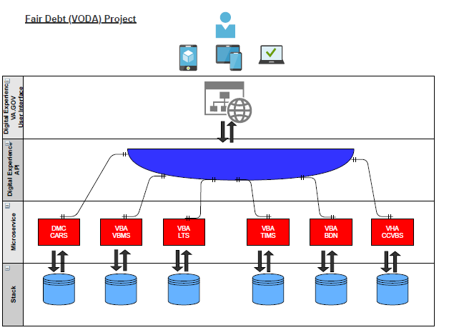
Way Forward
Each Department Provides needed Data Elements via API to the Digital Experience Team.
The Digital Experience Team builds out the user interfaces and enhancements based on the data provided from each department.
Notes:
Goal of slide:
Show all applications in scope of the program with a quick view of health or progress.
List applications that the program must impact. Group by dependency, high to low. This gives a quick view of the complexity of the program, and highlights potential trouble points.

Slide 20
Data Elements Needed Per Department
Lite Phase
File Number
Payee Number
Person Entitled
Deduction Code
Benefit Type
Amount Overpaid
Debt History
Debt ID
Date
Letter Code
Status
Description
Notes:
Goal of slide:
Provide detail on the major program issues that require senior leadership assistance. There should be separate slides for each of the major issues.
Issues description:
provide a summary of the issue
Actions taken:
describe actions the program team has taken to address the issue.
Next steps:
describe the next steps the program team will take to address the issue.
Senior leadership action needed:
describe precise actions the program team requires of senior leadership.

Slide 21
Data Elements Needed Per Department
Comprehensive Feed
File Number
Payee Number
Person Entitled
Deduction Code
Benefit Type
Amount Overpaid
Debt History
Debt ID
Date
Letter Code
Status
Description
Current Amount Due
Minimum Amount Due
Consolidated Account Number
Previous Balance (30 days)
Payment Credits (30 days)
New Debts (30 days)
Fees Charged (30 days)
Interest Charged (30 days)
Transaction Reference Numbers (each transaction within 30 days)
Transaction dates to go with reference numbers
Transaction Detail descriptor to go with reference numbers
Fee Reference numbers
Fee Dates
Fee Detail Descriptor
Interest Reference numbers
Interest Dates
Interest Detail Descriptor
Total charges year to date
Total Fee Charges year to date
Total Interest charges year to date
Notes:
Goal of slide:
Provide detail on the major program issues that require senior leadership assistance. There should be separate slides for each of the major issues.
Issues description:
provide a summary of the issue
Actions taken:
describe actions the program team has taken to address the issue.
Next steps:
describe the next steps the program team will take to address the issue.
Senior leadership action needed:
describe precise actions the program team requires of senior leadership.

Slide 22
Data Elements Needed Per Department (Continued)
Interest types
Interest rates for types
Current balance subject to type of interest rate
Interest Charged YTD per type of interest rate
Fee Types
Type of Charge for Fees
Charge Amount for Types of Fees
Charges YTD for Types of Fees
Notice of changes to account in last 30 days
Notes:
Goal of slide:
Provide detail on the major program issues that require senior leadership assistance. There should be separate slides for each of the major issues.
Issues description:
provide a summary of the issue
Actions taken:
describe actions the program team has taken to address the issue.
Next steps:
describe the next steps the program team will take to address the issue.
Senior leadership action needed:
describe precise actions the program team requires of senior leadership.

Slide 23
QUESTIONS?

